Slide 1
AI FOR GOOD · HACKATHON 3
MigrationHelp
A clearer route through Dutch paperwork
Python + Gemini API
SDG 10 · Reduced Inequalities
Maximilian Lopez · Quinten van Ingen
Week 3 · 24 September 2026
Notes:
Opening: MigrationHelp helps newly arrived adults understand their first Dutch administrative steps. The tool uses Python to call Gemini, but it only lets Gemini explain facts selected from a curated official source pack. Team: Maximilian Lopez and Quinten van Ingen.

Slide 2
PROBLEM DEFINITION · 2 POINTS
The inequality is an information gap
Dutch public services are online and fragmented. New arrivals can face language barriers exactly when deadlines and correct sequencing matter.
3+ million
16.8%
10.2%
residents were born abroad on 1 January 2025
of the population was born outside the Netherlands
of migrants reported little or no Dutch in 2023
The National Ombudsman warns that foreign nationals may not speak Dutch and can struggle to find the right route through government.
This is not only a translation problem. It is a navigation and verification problem.
Notes:
Sources: Statistics Netherlands, foreign-born residents: https://www.cbs.nl/en-gb/dossier/asylum-migration-and-integration/how-many-residents-of-the-netherlands-have-a-non-dutch-background-
Statistics Netherlands, Dutch language proficiency among migrants: https://www.cbs.nl/en-gb/news/2023/44/good-command-of-dutch-enhances-labour-participation
National Ombudsman, foreign nationals dossier: https://www.nationaleombudsman.nl/vreemdelingen
Explain that the figures show scale and language need. The Ombudsman evidence connects that need to government navigation.

Slide 3
USER GROUP · 2 POINTS
One clear user, with clear boundaries
Built for
Not designed for
Recently arrived adults in the Netherlands who have limited Dutch and need a first administrative route.
• Asylum or residence decisions
• Emergencies
• Legal or medical advice
• Children using it alone
• Case-specific undocumented status questions
Typical questions
• Where do I register?
• How do I get a BSN or DigiD?
• What should I arrange first?
Why narrow the scope?
A small source pack is easier to verify and safer to explain.
No account or identity number is needed
Notes:
The user group is deliberately narrow. A recent arrival may not know which authority owns which step, and limited Dutch makes official pages harder to compare. Exclusions matter because the prototype is not qualified to decide legal status, health treatment, emergencies or child safeguarding.

Slide 4
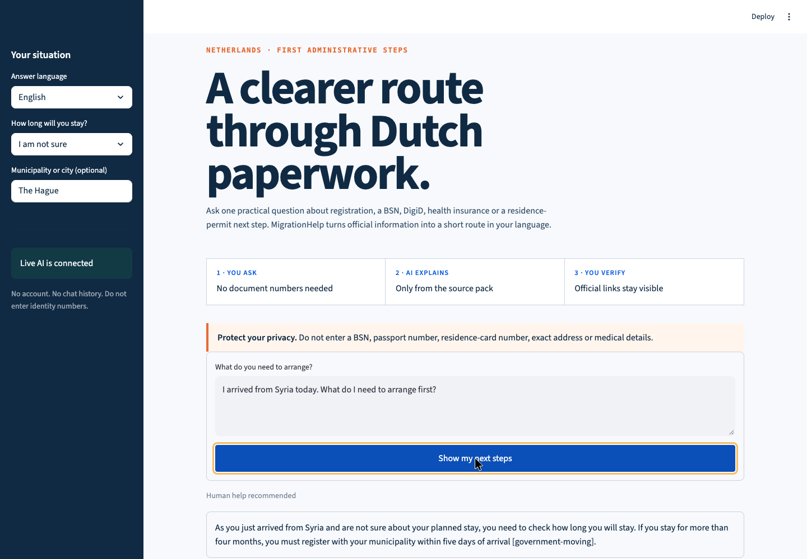
SOLUTION DESCRIPTION · 2 POINTS
The product turns a question into a verified route
What the user gets
1
A direct answer in the chosen language
2
No more than four ordered steps
3
Official links remain visible
4
Warnings and human handoff when risk is high
The AI explains. It does not make eligibility decisions.
Notes:
Live product screenshot captured on 24 September 2026 from the local Streamlit app. The question was: I arrived from Syria today. What do I need to arrange first? The returned answer was marked high risk and linked to official Government.nl pages. Demo file: demo/MigrationHelp-demo.webm.

Slide 5
ACTUAL CODE FROM ASSISTANT.PY
The Gemini API call in Python
Python creates the client, defines a strict response format and sends one request.
1
Create the client
api_client = client or genai.Client(
api_key=os.getenv("GEMINI_API_KEY")
)
config = types.GenerateContentConfig(
system_instruction=SYSTEM_INSTRUCTIONS,
response_mime_type="application/json",
response_schema=GEMINI_RESPONSE_SCHEMA,
max_output_tokens=700,
temperature=0.2,
)
response = api_client.models.generate_content(
model=model,
contents=user_context,
config=config,
)
return _parse_answer(response.text, sources)
Python reads GEMINI_API_KEY from the local .env file. The key never appears in the code or GitHub.
2
Control the output
The config asks for JSON that matches our schema. Temperature 0.2 keeps the wording more consistent.
3
Make the API request
contents contains the question, chosen language and selected facts from official sources.
4
Validate the response
_parse_answer checks the fields, step limit, risk level and every cited source ID before display.
Notes:
This slide contains the real call from migrationhelp/migrationhelp/assistant.py. Explain it line by line: genai.Client authenticates with the key from .env. GenerateContentConfig supplies the system rules, asks for JSON and gives Gemini the required schema. generate_content sends the chosen model, user_context and config to Google's API. Gemini returns response.text. _parse_answer uses Pydantic and validate_source_ids before Streamlit receives the answer. A temporary Gemini ServerError triggers the configured fallback model once.

Slide 6
API EXPLANATION
What the Python code does
One user action triggers one controlled Gemini request, followed by Python validation.
1
2
3
4
5
Read input
Check safety
Select facts
Call Gemini
Validate
app.py
safety.py
knowledge_base.py
generate_content()
assistant.py
Language, stay length, city and question
Blocks identity numbers and emergency queries
Chooses relevant official source records
Sends the question, facts and JSON schema
Rejects missing fields, extra steps or invented sources
If validation fails, the generated answer is hidden and the app shows safe official links instead.
Notes:
Simple code explanation: Streamlit collects four inputs in app.py. Python checks for private identifiers and emergencies in safety.py. knowledge_base.py selects relevant facts and source IDs. assistant.py builds the prompt and calls client.models.generate_content using the Gemini model. Gemini must return structured JSON. Python parses it and validates required fields, step count, risk value and source IDs. If anything is invalid or the API fails, the answer is not displayed.

Slide 7
WORKING PROTOTYPE · 1 POINT
The prototype works and fails safely
9 / 9
LIVE
2 models
automated tests passing
Gemini API call verified
temporary outage fallback
Safety, source selection, parsing and fallback behavior
Real answer, ordered steps and official citations
Primary model retries once with a configured fallback
Edge cases handled in Python
Private data
Blocks BSN, passport and residence-card patterns
Emergency
Stops the AI flow and directs the user to urgent help
Bad AI output
Rejects invalid JSON, too many steps and invented source IDs
API unavailable
Shows a neutral error and keeps verified official links visible
Notes:
Evidence produced on 24 September 2026: pytest reported 9 passed. A live Gemini request returned a high-risk response for a new arrival from Syria in The Hague, with four ordered steps and only source IDs supplied by Python. The recorded demo is in demo/MigrationHelp-demo.mp4. The fallback handles temporary 5xx server errors, while validation still applies to the fallback response.

Slide 8
ETHICAL REFLECTION · 2 POINTS
The biggest risk is confident wrong guidance
A wrong answer could harm the person least able to verify it, causing a missed deadline, lost access to services or false confidence.
How we limit that risk
Curated facts
Gemini receives only selected Government.nl and IND records
Still imperfect
✓
✓
Structured output
The answer must match a defined JSON schema
• Translation quality differs by language
• Rules can change after source review
• A small source pack cannot cover every case
✓
Source validation
Invented source IDs cause the answer to be rejected
✓
Visible verification
Official links and limitations remain next to the answer
✓
Human handoff
High-risk cases are labelled for human help
Prototype, not a legal service
Notes:
Ethical reflection: The largest risk is an authoritative but wrong answer reaching someone who cannot easily verify it. That could lead to missed deadlines or loss of access to services. We limit the risk by grounding Gemini in a curated source pack, requiring structured JSON, validating every cited source ID, blocking sensitive identifiers, showing official links and hiding any answer that fails validation. Residual risks remain: translation quality is uneven, rules change and the source pack is incomplete.

